Slide 1

Analysis Of clients' review on the airways
By K.Poornima
03/03/2022

Slide 2
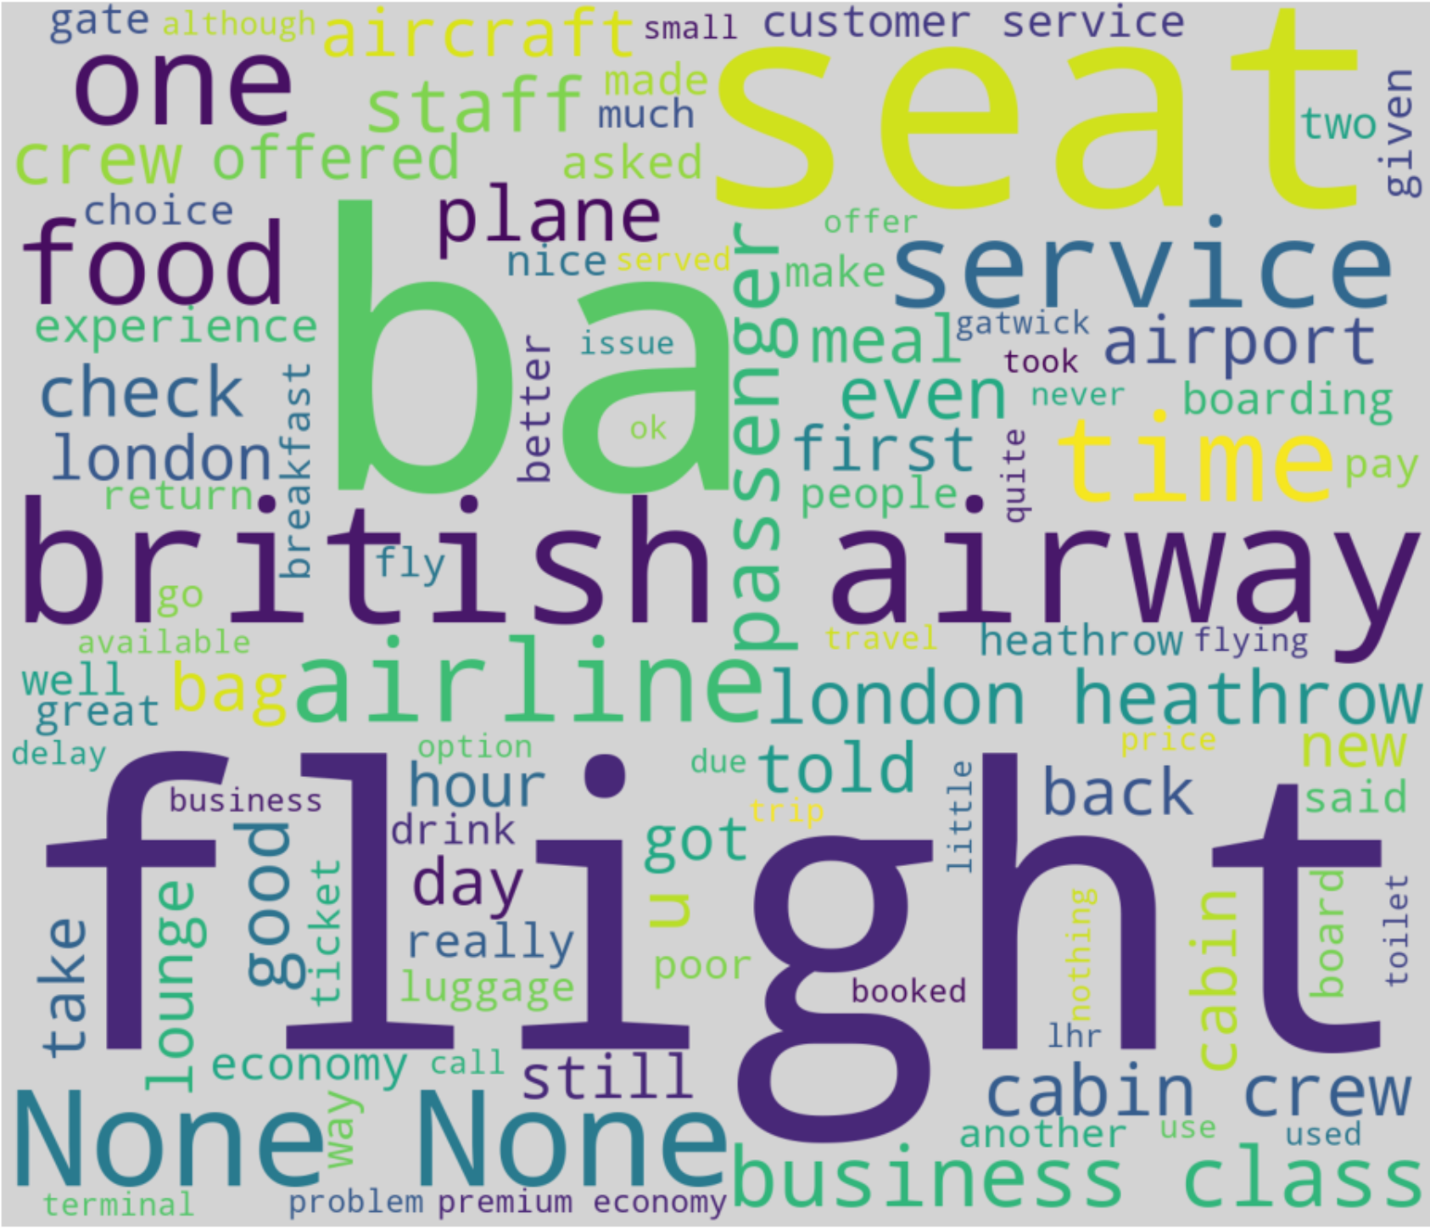
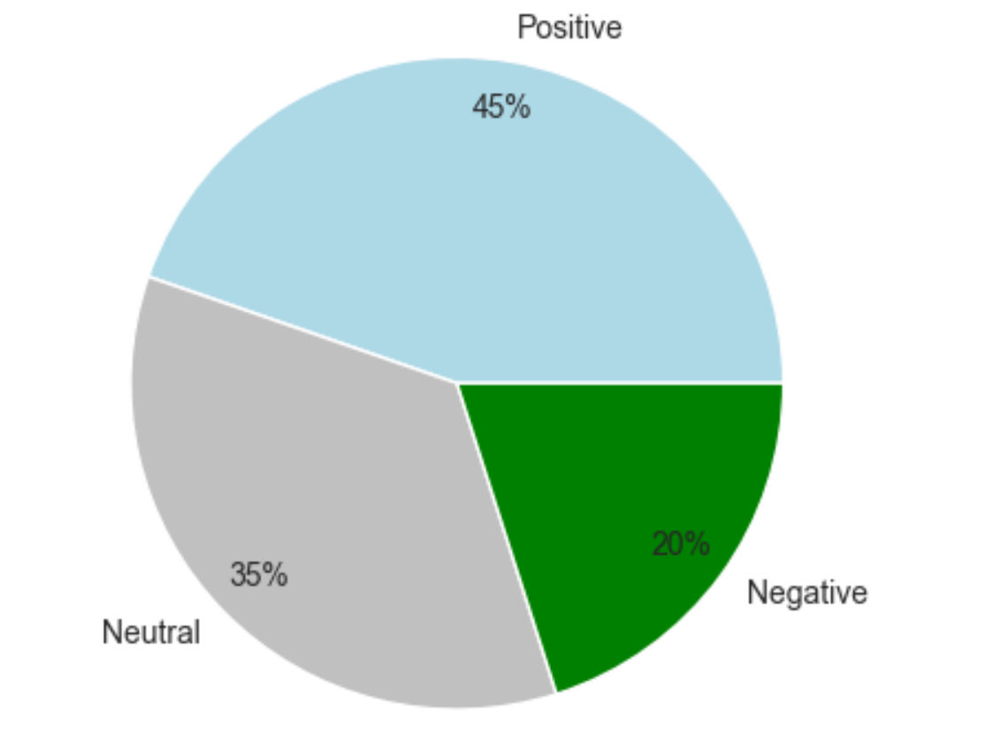
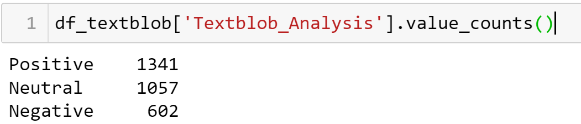
INSIGHTS FROM CLIENT REVIEWS
Distribution of sentiments
Wordcloud (100 words)

